Slide 1
Azure AD for non-developers
Rory Braybrook
Microsoft Identity Architect
Microsoft MVP
@rbrayb

Slide 2
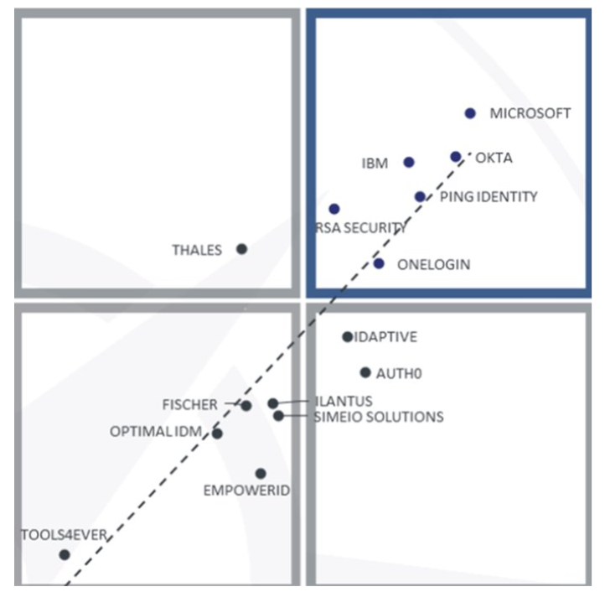

Slide 3
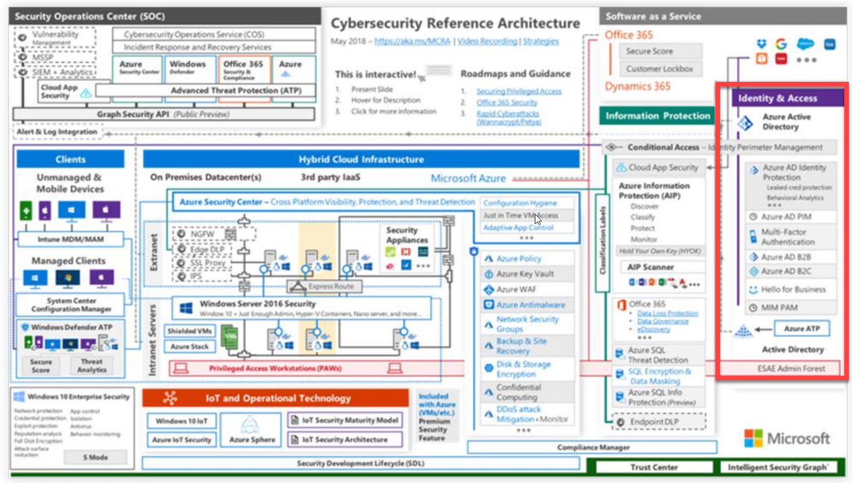

Slide 4
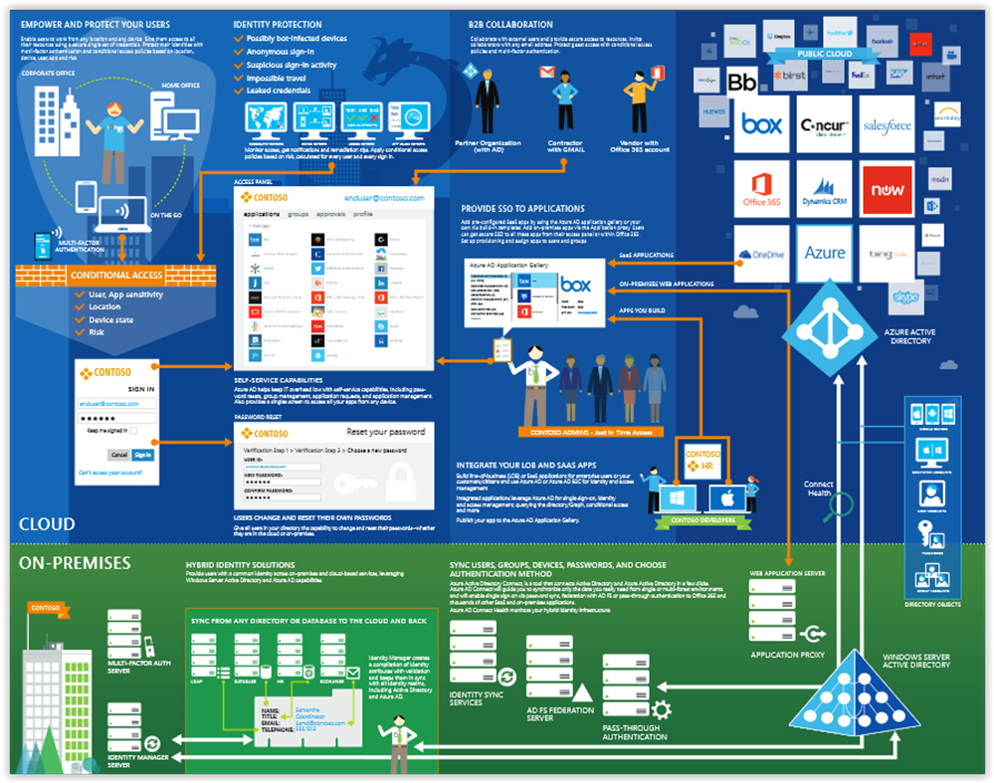

Slide 5
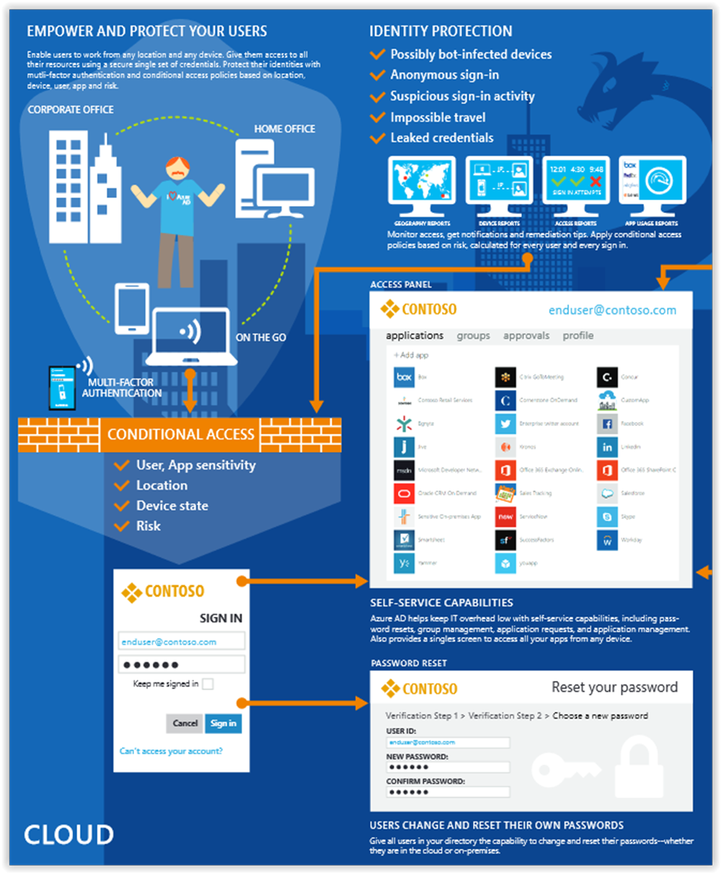

Slide 6
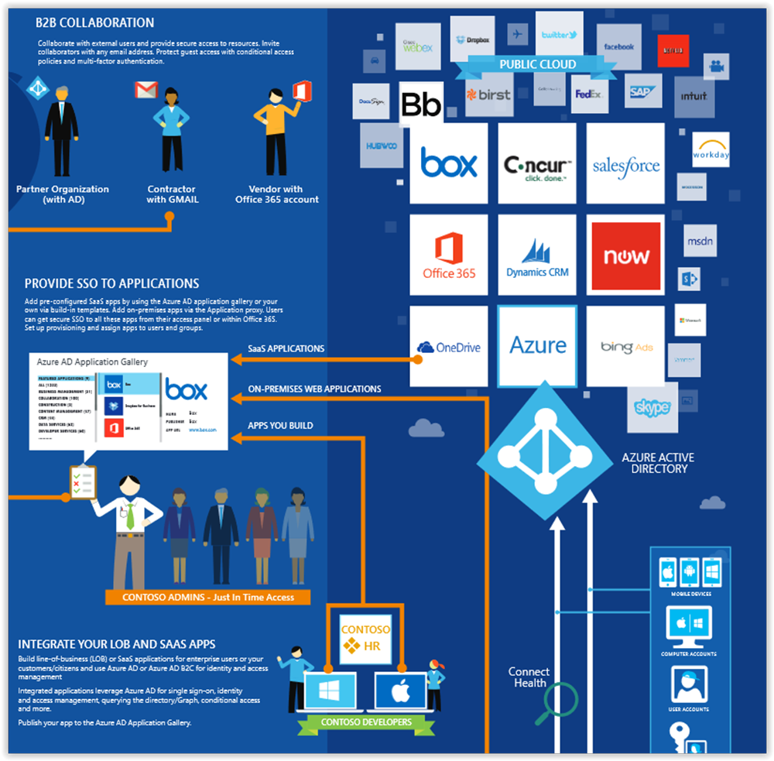

Slide 7
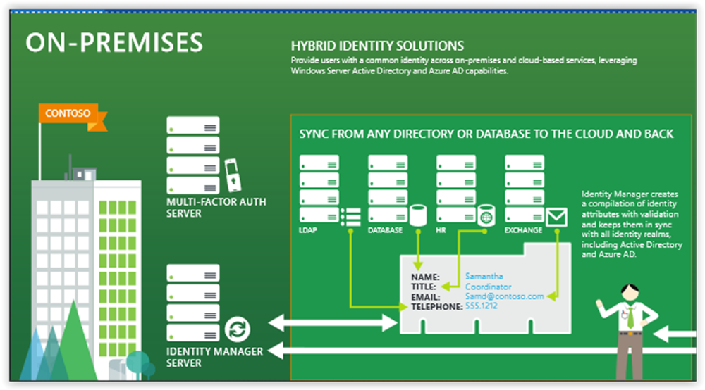

Slide 8
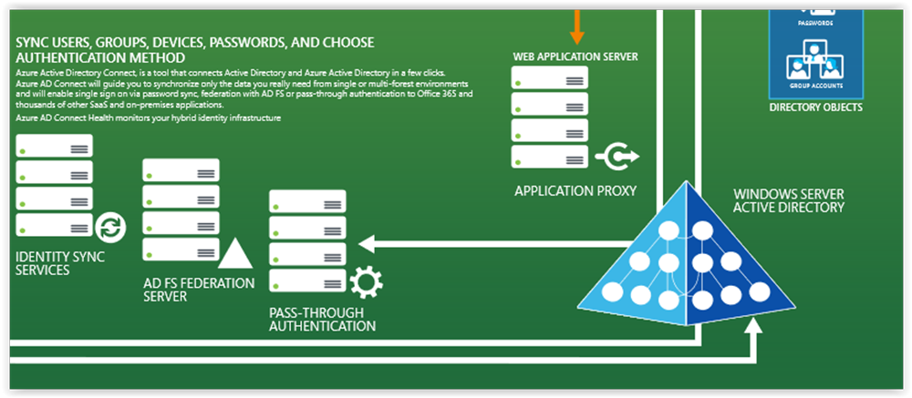

Slide 9
Azure AD
Not AD in the cloud
Graph API not LDAP calls
Not hierarchical
Underpins Office 365
Azure AD manages more than 1.2 billion identities and processes over 8 billion authentications every day
Protocols
WS-Federation
SAML 2.0
OpenID Connect / OAuth

Slide 10



Authentication Scenarios
Browser
Web application
Web API
js
Native app
Web API
Web API
Server app
Clients using wide variety of devices/languages/platforms
Server applications using wide variety of platforms/languages

Slide 11
Authentication Scenarios
WS-Fed, SAML 2.0, OpenID Connect
Web application
OAuth 2.0
Web API
Browser
js
OAuth 2.0
Native app
OAuth 2.0
Web API
Web API
Server app
OAuth 2.0
OAuth 2.0
Standard-based, http-based protocols for maximum platform reach

Slide 12
Pricing
Azure Active Directory Free. Provides user and group management, on-premises directory synchronization, basic reports, self-service password change.
Azure Active Directory Premium P1. In addition to the Free features, P1 also lets your hybrid users access both on-premises and cloud resources. It also supports advanced administration, such as dynamic groups, self-service group management, and cloud write-back capabilities, which allow self-service password reset for your on-premises users.
Active Directory Business-to-Customer (B2C).

Slide 13
Pricing
Azure Active Directory Premium P2. In addition to the Free and P1 features, P2 also offers Azure Active Directory Identity Protection to help provide risk-based Conditional Access to your apps and critical company data and Privileged Identity Management to help discover, restrict, and monitor administrators and their access to resources and to provide just-in-time access when needed.
"Pay as you go" feature licenses. You can also get additional feature licenses, such as Azure Active Directory Business-to-Customer (B2C).

Slide 14
Features
Application management – AD proxy, MyApps (Access panel), SaaS
Authentication - self-service password reset, Multi-Factor Authentication, custom banned password list, smart lockout
B2B – guest users, invite, federation, Google
B2C – customer self-service
Conditional access – access rules
Identity platform – set of libraries for dev.
Device Management – Intune – mobile
Entitlement management

Slide 15
Features
Domain services – DC aaS
Enterprise users – SAML
Hybrid identity – AAD Connect, Connect Health
Identity protection – ML to detect potential vulnerabilities
Privileged identity management (PIM) – manage admins.
Reports and monitoring

Slide 16
Risk detections
Users with leaked credentials
https://haveibeenpwned.com/
Sign-ins from anonymous IP addresses
Impossible travel to atypical locations
Sign-ins from infected devices
Sign-ins from IP addresses with suspicious activity
Sign-ins from unfamiliar locations

Slide 17
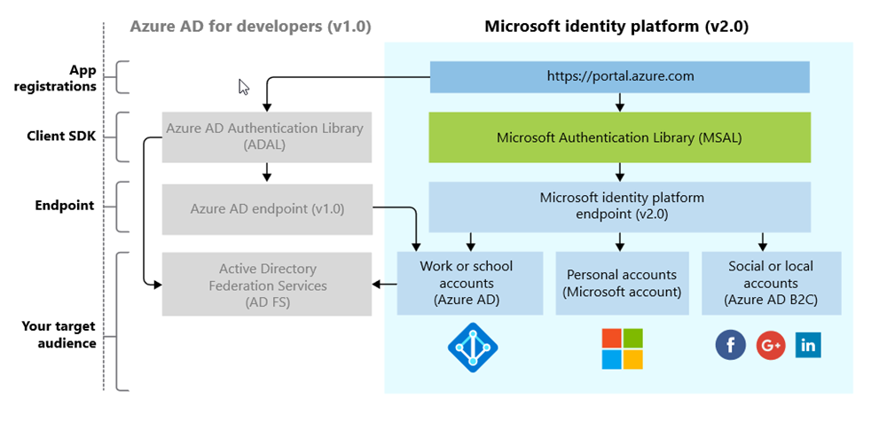
The Microsoft Identity Platform (not the Product!)

Slide 18

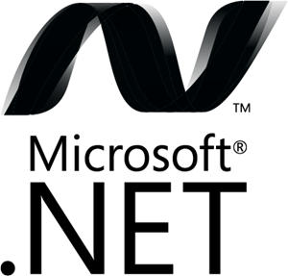




Microsoft Authentication Libraries (MSAL)
Generally Available:
GA
GA
GA
GA
GA
GA
JavaScript
.NET
Android
iOS/macOS
Production Supported Public Preview:
PREVIEW
PREVIEW
Java
Python

Slide 19
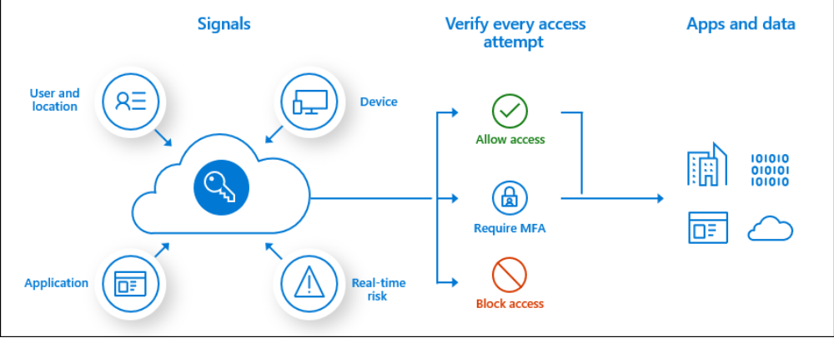
Conditional access

Slide 20
Conditional access
User or group membership
IP Location information
Device
Application
Real-time and calculated risk detection
Microsoft Cloud App Security (MCAS)

Slide 21
References
https://azure.microsoft.com/mediahandler/files/resourcefiles/cloud-identity-and-access-management/Cloud_Identity_and_Access_Management_infographic.pdf/
https://aka.ms/mcra
https://docs.microsoft.com/en-us/azure/active-directory/develop/

Slide 22


